Slide 1
Unit-5
User Interface Design

Slide 2
User Interface Design
Concept of User Interface Design
Definition: Designing the part of software/system that users directly interact with.
Goal: Make interaction simple, clear, and attractive.
Key Elements: Buttons, menus, icons, text boxes, forms.
Focus Areas: Layout, colors, typography, navigation flow.
Benefits: Easy to use, reduces confusion, saves time for users.

Slide 3



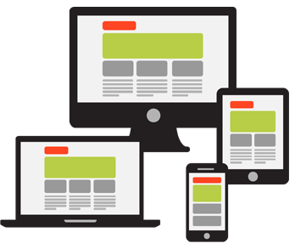
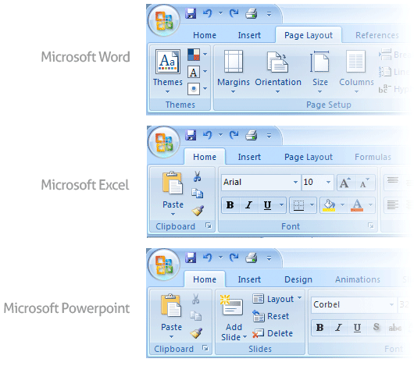
User Interface Design
Golden Rules of User Interface Design
Place the User in Control
Reduce the User’s Memory Load
Make the Interface Consistent

Slide 4
Golden Rules of User Interface Design Cont.
Place the User in Control
During a requirements-gathering session for a major new information system, a key user was asked about.
Following are the design principles that allow the user to maintain control:
Define interaction modes in a way that does not force a user into unnecessary or undesired actions.
Provide for flexible interaction
Allow user interaction to be interruptible and undoable.
Streamline interaction as skill levels advance and allow the interaction to be customized.
Hide technical internals from the casual user.
Design for direct interaction with objects that appear on the screen.

Slide 5

Golden Rules of User Interface Design Cont.
Reduce the User’s Memory Load
The more a user has to remember, the more error-prone the interaction with the system will be.
Following are the design principles that enable an interface to reduce the user’s memory load:
Reduce demand on short-term memory.
Establish meaningful defaults
Define shortcuts that are intuitive
The visual layout of the interface should be based on a real-world metaphor
Disclose information in a progressive fashion

Slide 6
Golden Rules of User Interface Design Cont.
Make the Interface Consistent
The interface should present and acquire information in a consistent fashion.
Following are the design principles that help make the interface consistent
Maintain consistency across a family of applications
If past interactive models have created user expectations, do not make changes unless there is a compelling (convincing) reason to do so

Slide 7

User Interface Analysis and Design Models
User profile model – Established by a software engineer
  Establishes the profile of the end-users of the system
  based on age, gender, physical abilities, education, cultural background, motivation, goals, and personality.
Design model – Created by a software engineer
  Derived from the analysis model of the requirements.
  Incorporates data, architectural, interface, and procedural representations of the software.
Implementation model – Created by the software implementers
  Consists of the look and feel of the interface combined with all supporting information (books, videos, help files) that describe system syntax and semantics.
User's mental model – Developed by the user when interacting with the application
  Often called the user's system perception.
  Consists of the image of the system; that users carry in their heads.
The role of the interface designer is to merge these differences and derive a consistent representation of the interface.

Slide 8

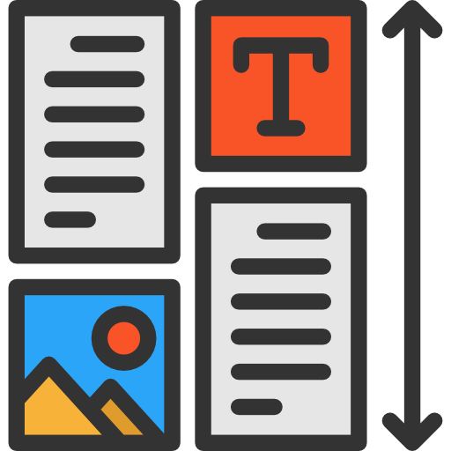
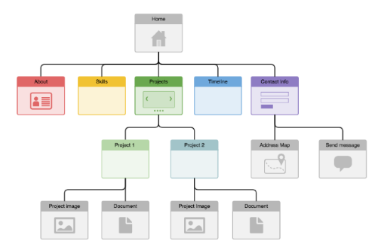


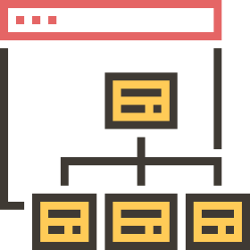
Web Application Design
Design for WebApp encompasses technical and nontechnical activities that include:
Establishing the look and feel of the WebApp
Defining the overall architectural structure
Developing the content and functionality that reside within the architecture
Planning the navigation that occurs within the WebApp

Slide 9
Designing UI using UX Design
UI (User Interface): The look & feel – buttons, menus, colors, icons.
UX (User Experience): The overall journey – how easy and satisfying it is for the user.
Relation:
UX design decides what experience the user should have.
UI design shows how that experience looks on screen.
Steps in Designing UI with UX:
Understand user needs (research).
Create wireframes & flow (UX).
Apply visual elements (UI).
Test usability & improve.
Goal: Make software not only attractive (UI) but also meaningful & user-friendly (UX).

